Slide 1

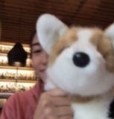

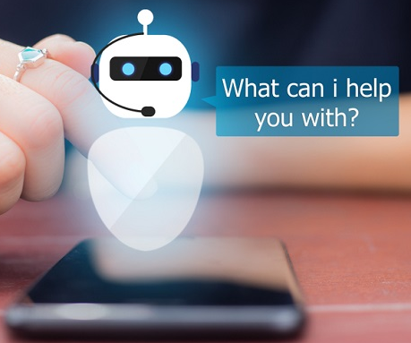

Module 3.7
Mini-Project Overview
Living and Working with Artificial Intelligence
Developed for the AI4GA (Artificial Intelligence for Georgia) project funded by National Science Foundation awards DRL-2049029 and DRL-2048502.
This work is licensed under the Creative Commons. Attribution-NonCommercial-ShareAlike 4.0 International License. https://creativecommons.org/licenses/by-nc-sa/4.0/

Slide 2
Learning Objectives
Students should be able to:
Understand what makes an AI biased and how to limit bias.
Build AI models and systems that are fair, ethical, and, transparent.
Consider the users of your AI system.

Slide 3
For the Unit 3 Mini-Projects
We want to empower you to create AI models and systems, as AI Designers and Developers.
Every person involved in the creation of AI at any step is accountable for considering the system’s impact in the world
Being an AI Designer has some responsibilities:
Consider the users of your AI system - evaluate the potential positive and negative impacts at every step of AI design, development, decision processes, and outcomes to your users.
Limit bias in their datasets and training
Build AI models and systems that are fair, ethical, and, transparent.

Slide 4
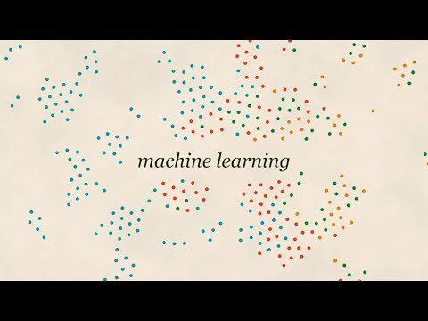
Types of Bias in ML - Things we want to avoid
https://youtu.be/59bMh59JQDo (2 mins 33 secs)

Slide 5
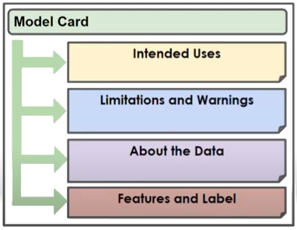
Model Cards - Responsible use of AI Models
Model cards are an attempt to ensure that machine learning models are used responsibly.
Intended Use:
  What problem was this model created to solve?
Limitations and Warnings:
  Does the data represent all possible users and scenarios, or is it limited?
  Is the dataset large enough to be confident in the model’s accuracy?
  Are there situations where the model should not be used?
About the Data:
  Where did the data come from?
Features and Label:
  What features are being used?
  How were these feature values measured?
  How were labels assigned?

Slide 6
For the Unit 3 Mini-Projects
You will have the option to use one of three AI Model development tools
You will create an AI model & system using a pre-existing project template or come up with a project idea of your own
You will then complete a reflection on the AI model & system you created that includes
Description of your system and its goal
Description of your target users
Evaluate the potential positive and negative your system can have on your users
Steps taken to reduce and limit bias in your dataset and model training
Create a Model Card - describing the intended use of your system, source of data, limitations, and warnings.

Slide 7
Unit 3 Mini Project Options - Pick a tool & project
Train a Visual Classifier
Tool: Teachable Machine
Description:
Use camera or images to create a dataset & create a classifier to recognize different objects, people, or gestures. Extend the project using Scratch into a game.
Build a ML for Kids Project
Tool: Machine Learning for Kids (ML4K) & Scratch
Description:
Pick a project from the ML4K website and complete it. Note: some require using the ML4K model in a Scratch project.
Dataset Classifier or Predictor
Tool: AI Lab (Code.org)
Description:
Pick a dataset or create your own dataset, train a classifier or predictor. Use AI lab to extend the project into a mobile app

Slide 8
Since you are developing your own AI models & systems, you need to remember the ML pipeline for each system.
You’ll notice that the project details follow the steps or stages in these ML pipelines.

Slide 9
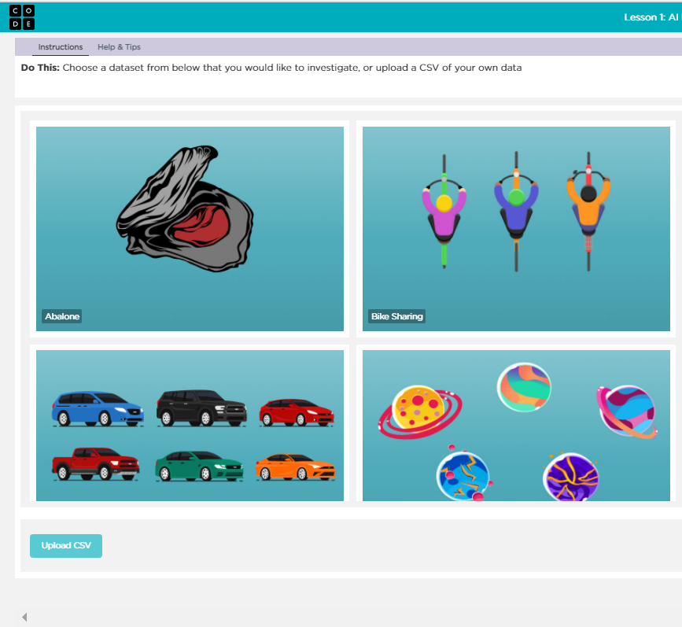
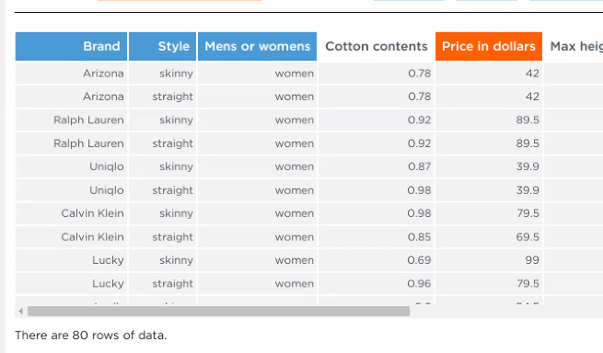
The AI Lab Machine Learning Pipeline
In Module 3.5, we used Code.org’s AI lab to create a predictive model from an existing dataset
Men’s or Women’s
Style
Brand
Cotton content
Size of pockets
What features best predict the price of jeans?
Price of Jeans
Build Dataset
Identify a dataset & review features
Identify a question
Select feature to predict
Select features that affect the feature to be predicted
Train a classifier
If accuracy low
Test
Use the model in a system
Test the model
Review Accuracy
Notes:
Teacher Note: This pipeline has a lot of similarities to the one we use for machine learning for kids. But it has several differences.
Step 1 - We don’t need to collect our own data because we have a datasets that others have already created for us. When we look at this data set we can see that there are already a number of features identified in the columns and the rows of the table are filled with examples.
Step 2 - So instead of defining features, we have to identify a question we want to answer with our data
Step 3- then we will select the feature we want to predict
Step 4 - then we will select the features we think will help us predict the feature we selected

Slide 10
The Teachable Machine Pipeline
In Module 3.1, we used Code.org’s AI lab to create a dataset and trained a visual classifier for peace sign vs thumbs up
Build Dataset
Test
Identify the question
Identify the classes (labels)
Collect your data for each class
Train a classifier
Collect test data
If accuracy low
Use the model in a system
If accuracy is high
Test the model with users
If accuracy is high
Review Accuracy
Test the model

Slide 11
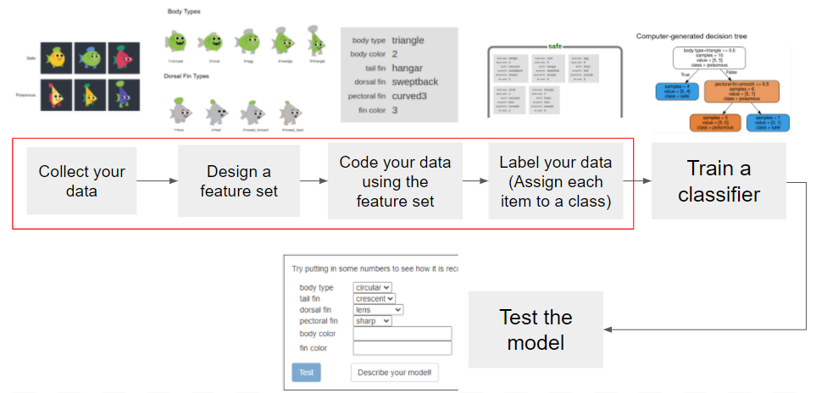
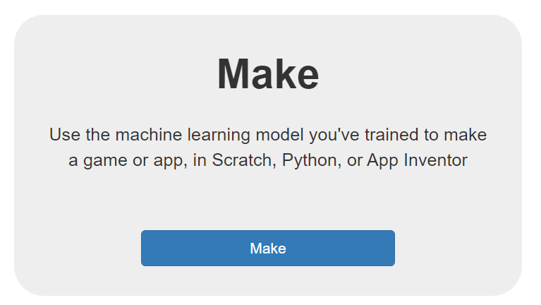
The ML4K Tool Pipeline
Build Dataset
Use the model in a system

Slide 12
Project Tools & Details

Slide 13
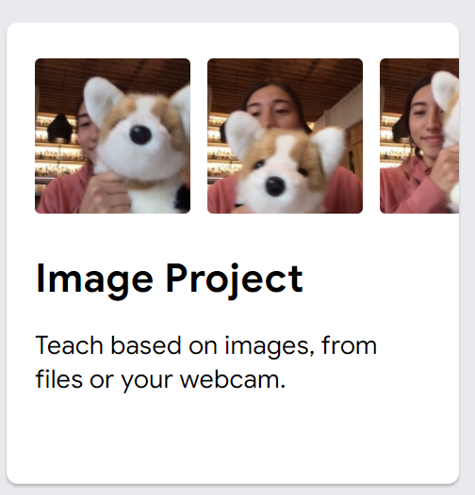
Train a Visual Classifier
Train a Visual Classifier
Tool: Teachable Machine
Description:
Use camera or images to create a dataset & create a classifier to recognize different objects, people, or gestures. Extend the project using Scratch into a game.
Step 1: Open Teachable Machine in the browser
https://teachablemachine.withgoogle.com/train
Step 2: Select the Image Project
Step 3: Create the Image Classifier
Identify a problem you want to solve
Gather Samples
Train Model
Test Model
Measure accuracy
Improve the accuracy of the model
(repeat steps 1-4)
Test it out with your friends
& improve the model.

Slide 14
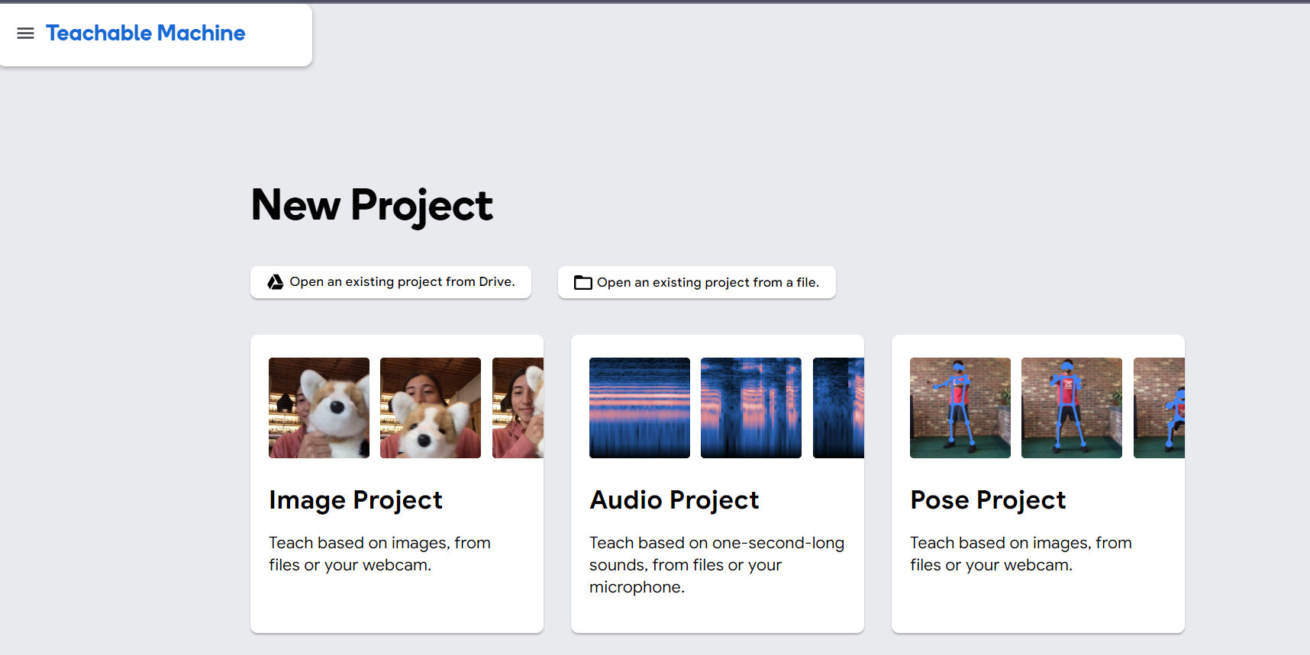

Slide 15
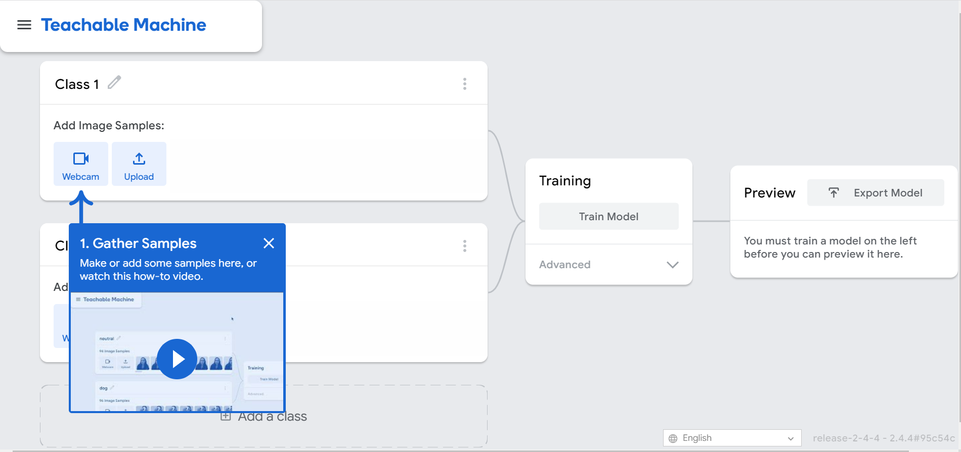
The Teachable Machine Pipeline
In Module 3.1, we used teachable machine to create a dataset and trained a visual classifier for peace sign vs thumbs up
Collect image data or upload image dataset

Slide 16
Teachable Machine - Exporting your model & saving dataset
Check out this link for details about
Save your entire project to Google Drive.
You can save your project to your Google Drive. This saves a .zip file that contains all the samples in each of your classes to Drive. You can then open that .zip again from Teachable Machine later to pick up where you left off.
Download your samples.
You can download all the samples in each class, and upload them later if you want to keep working with the same data.
Download your model.
If you download your model, and close your tab, you can use that downloaded model later — and nothing is saved on any servers.
Save nothing.
If you close your tab and do none of the above, nothing is saved in your browser or on any servers.

Slide 17
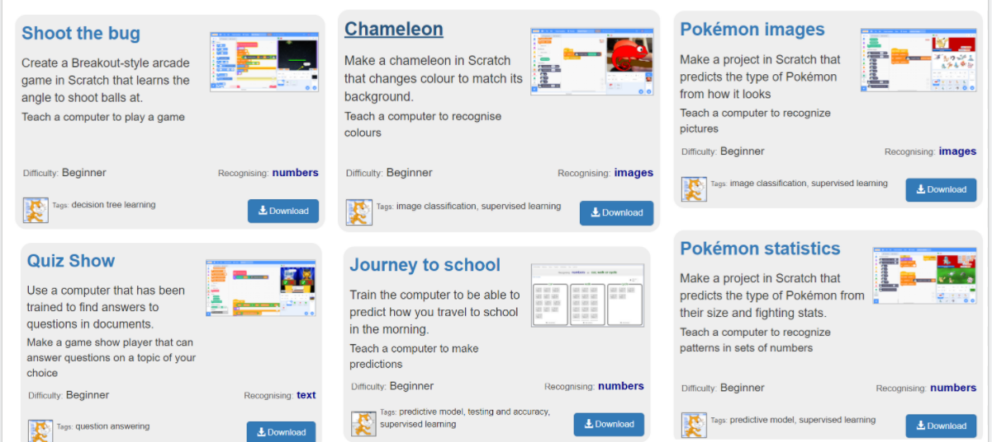
Build a ML for Kids Project
Step 1:Open ML for Kids - https://machinelearningforkids.co.uk/
Step 2: Pick a project
Select Worksheets from the top menu and then Beginner projects from the project search options
Browse the projects and click download the student project worksheet.
Step 3: Follow the instructions on the worksheet to create a ML4K Model
Step 4: Follow the instructions on the worksheet to import and use your model in Scratch
Step 5: Test the model & evaluate the accuracy
Build a ML for Kids Project
Tool: Machine Learning for Kids (ML4K) & Scratch
Description:
Pick a project from the ML4K website and complete it. Note: some require using the ML4K model in a Scratch project.
example beginner projects

Slide 18
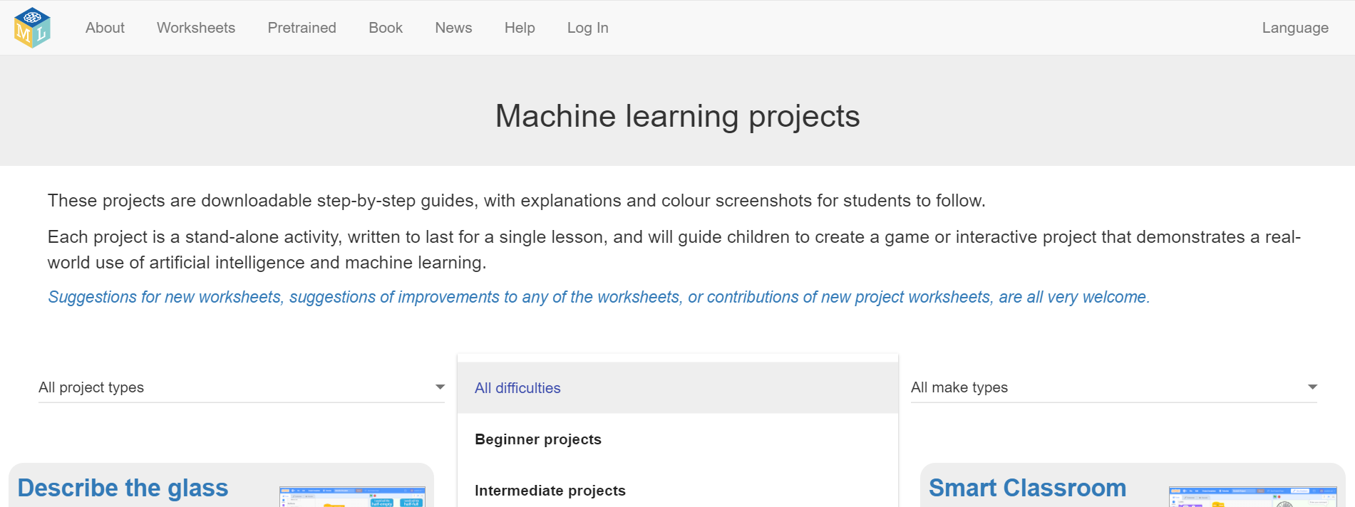
Finding Projects in ML for Kids
Select Worksheets from the top menu and then Beginner projects from the All difficulties search options

Slide 19
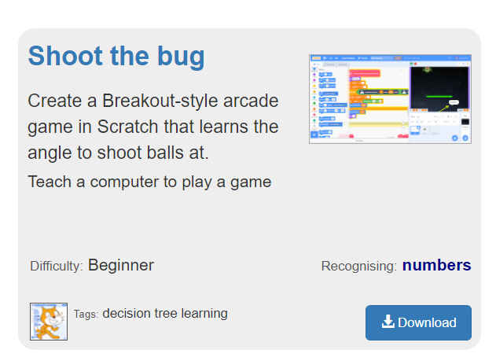
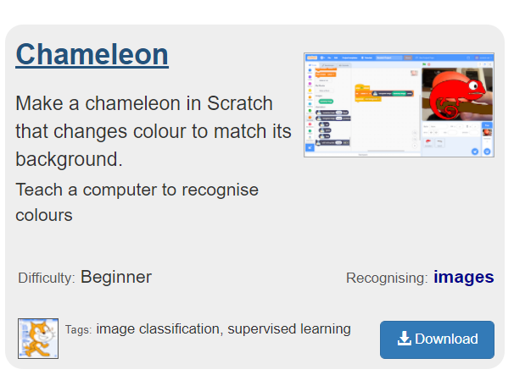
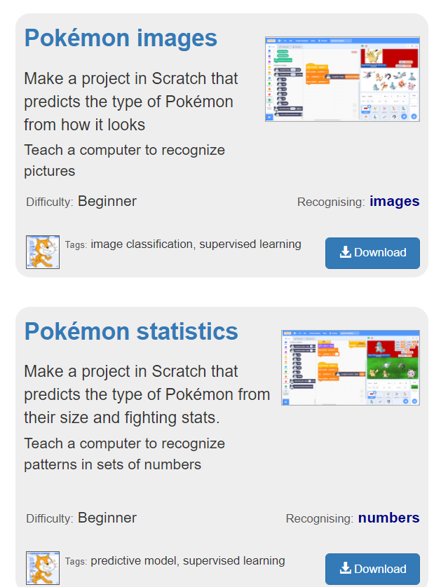
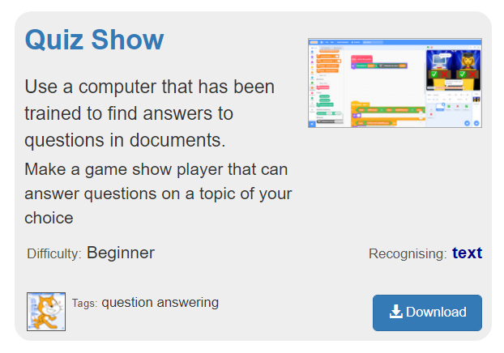
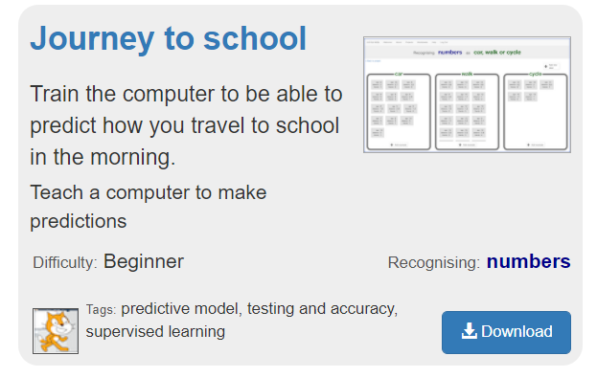
Machine Learning for Kids Projects (example beginner projects)

Slide 20
Unit 3 Mini Project Options - Pick a tool & project
Train a Visual Classifier
Tool: Teachable Machine
Description:
Use camera or images to create a dataset & create a classifier to recognize different objects, people, or gestures. Extend the project using Scratch into a game.
Build a ML for Kids Project
Tool: Machine Learning for Kids (ML4K) & Scratch
Description:
Pick a project from the ML4K website and complete it. Note: some require using the ML4K model in a Scratch project.
Dataset Classifier or Predictor
Tool: AI Lab (Code.org)
Description:
Pick a dataset or create your own dataset, train a classifier or predictor. Use AI lab to extend the project into a mobile app

Slide 21
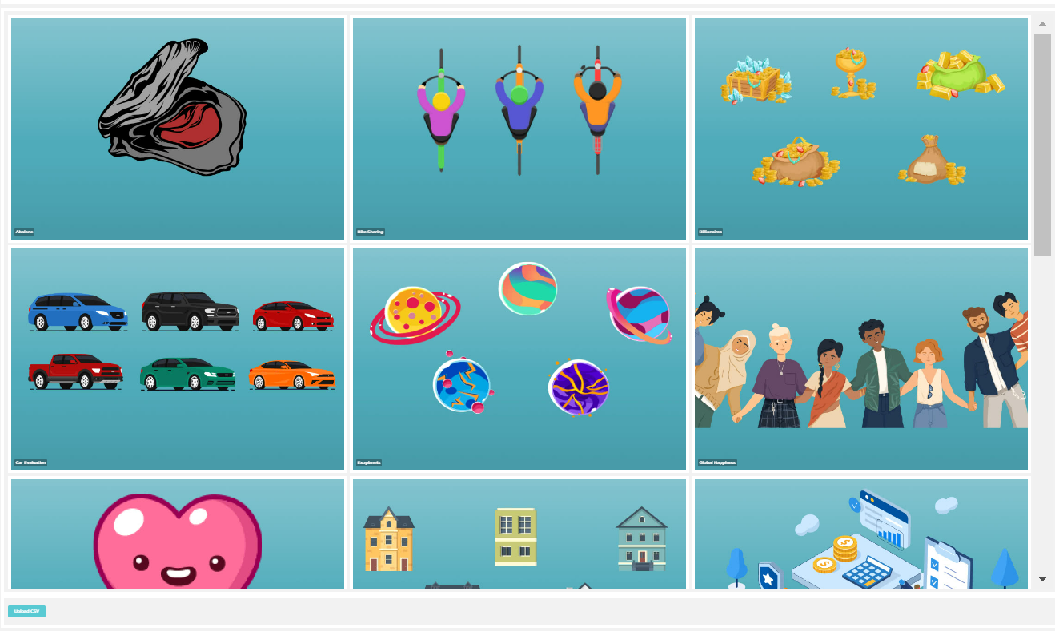
Train a Classifier or Predictor
Dataset Classifier or Predictor
Tool: AI Lab (Code.org)
Description:
Pick a dataset or create your own dataset, train a classifier or predictor. Use AI lab to extend the project into a mobile app
Step 1: Open Code.org’s AI Lab in the browser
https://studio.code.org/s/ai-lab/lessons/1/levels/2/sublevel/5
Step 2: Select a dataset
Step 3: Create the Classifier or Predictor

Slide 22
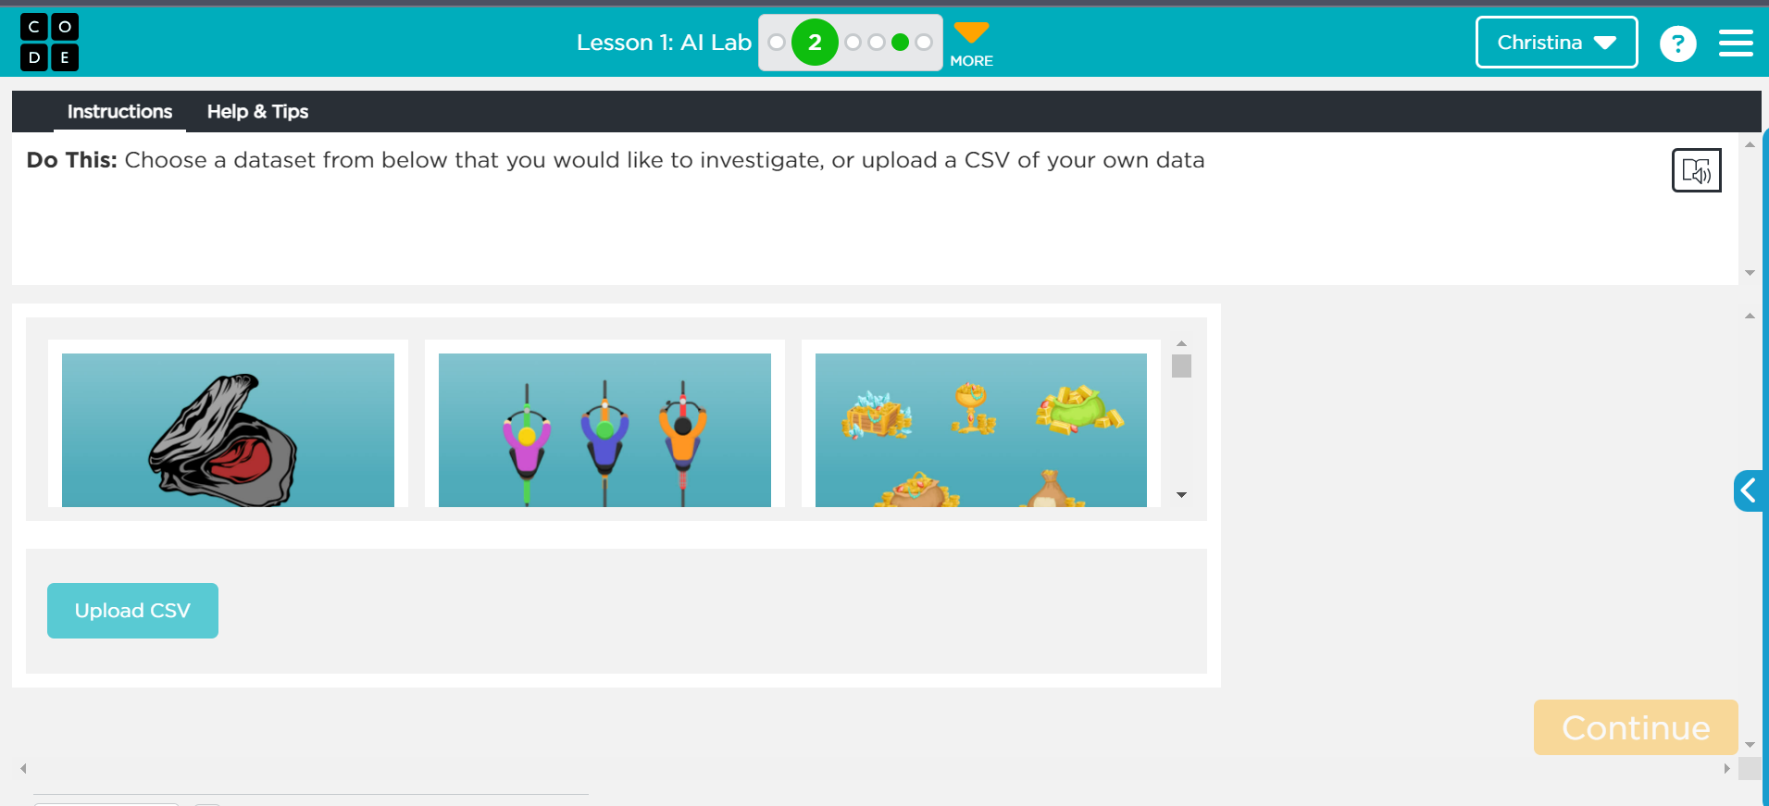
In Module 3.4, we used code.org’s AI Lab to create a dataset and trained a visual classifier for peace sign vs thumbs up

